Slide 1
Visualization and Data Analysis of Submeters Electric Power Consumption In a household
Itoro Etuks
July 16, 2019

Slide 2
Report To Management - Plan of Attack
Step One: Visualizations with Analysis Consisting of Day, Week and Minute Time
Step Two: Time Series Visualizations with Analysis of Sub-meters 1, 2 and 3.
Step Three: Linear Regression Forecast and Visualizations with Analysis of Sub-meters 1, 2 and 3. Including the Charts Built to Compare the R2 and RMSE of Each Model.
Step Four: Decomposition Visualizations with Analysis of Sub-meters 1, 2 and 3. Including the Charts Built to Compare the Summary Statistics for the Seasonal, Trend and Remainder Components from Each Decomposed Object.
Step Five: Holt Winters Forecasting and Analysis Consisting of Sub-meters 1, 2 and 3. Each Set is Composed from the Forecast Plot and Plot Containing Only the Forecasted Area.
Any Useful Correlations or Predictions you Gleaned from the Data.
A Summary Statement that Addresses the Goals of this Project.
High-Level Recommendations Based on Visualization and Analysis of the Power Consumption Data.
Lessons Learned.

Slide 3
STEP ONE: VISUALIZATIONS WITH ANALYSIS OF WEEK, DAY, AND MINUTE TIME PERIODS
SUBSET, VISUALIZE AND ANALYZE THE DATA
Key Points To Consider:
Keeping the business objectives in mind, we look for any trends or patterns in energy consumption data that would be of any value.
To gain detailed insights through exploratory analysis of over 1.5 million observations after our initial data munging.
Data needs to be subset into meaningful time periods for better visualizations and insight analysis.
1.1 Subset Time Periods
From the data description we know the observations were taken once per minute over period of almost 4 years. From this information, data sets of subset time periods can be generated for more in-depth time series analysis. One of the goals of sub-setting for visualization is to adjust granularity to maximize the information to be uncovered. Granularity describes the frequency of observations within a time series data set.

Slide 4
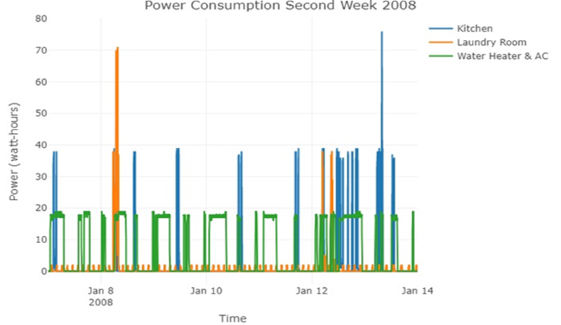
Visualizations with Analysis of Winter Week 2008
1.1.1
First, taking a sample look at second week of January visualization on all three Sub-meters using scatter lines mode plot.
We notice energy usage peaks at different times of the day and different days of the week, particularly, in Sub-meters 2 and 3. Curiously, we’d like to dive deeper into a day visualization.

Slide 5
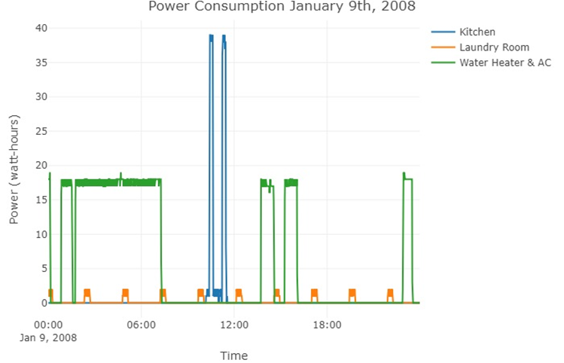
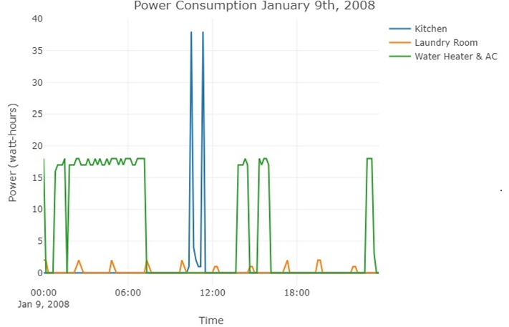
Visualizations with Analysis of Winter Day 2008
Now, with granularity adjustment, we could clearly see energy usage peaks at different hours of the day particularly, in Sub-meters 2 and 3.
1.1.2 Pattern:
Higher energy usage is at midnight, early morning, and mid-afternoon.
Small energy peaks in laundry area every 2 to 2.5 hours.
The homeowner also seems to use high energy in the kitchen area once a day but at different time periods.
We also Compare January 9th of 2008 to same date in 2009, there seems to be a pattern of high energy peak in Sub-meter 3 during same time periods of the day.
Plot Showing Day Subset With Granularity
Plot Showing Day Subset With Granularity Adjustment for Clarity - 10 Minutes Intervals

Slide 6
Analysis of Winter Week, Day, Minute 2008
Sub-meter 3
With the granularity adjusted we get a clearer picture of the power consumption on January 9th, 2008
The charts show higher energy usage in Sub-meter 3 between 11 PM and 6 AM the following day.
Considering the seasonality of the period, this peaks might represent water heater usage because the home will not need AC usage in winter period.
Water heater might be used around 6:30 AM for bathing.
It is also possible that more hot water for dish washing and every running water activity in the house due to cold weather. This requires the water heater appliances to over-work to maintain hot water in the tanks
Therefore, the spikes in energy usage in Sub-meter 3 may not be related to AC usage, since this is a winter month in CST
There seems to be high energy usage at night (10 PM - 1 AM). Again, from 1:40PM to about 4 PM)
Sub-meter 2
Energy usage seems to peak every 2 to 2 1/2 hours throughout the day in the laundry area.
There may be an energy regulator device or energy saving appliances in the laundry area.
Sub-meter 1
The homeowner uses more energy for kitchen appliances between 10:40 AM and 11:10 AM but once during the day.
The information in these data is limited. A pattern and trend may be required to make decision. The kitchen area only has high energy consumption between 10 AM and 12 PM.

Slide 7
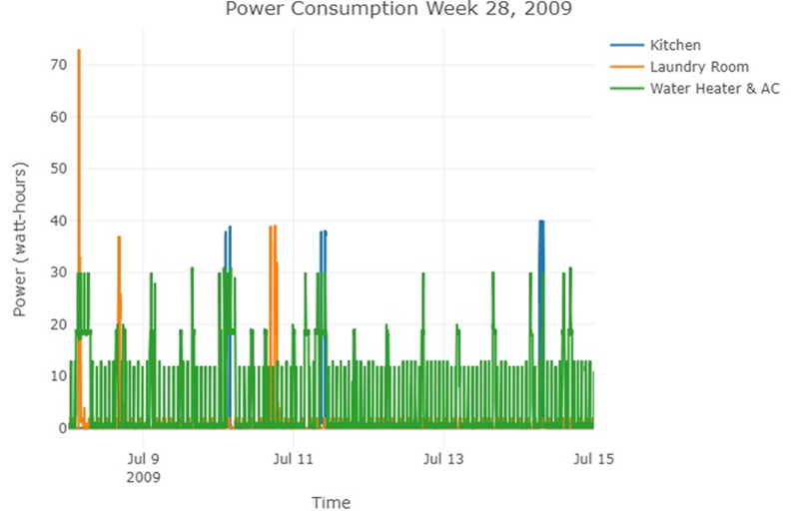
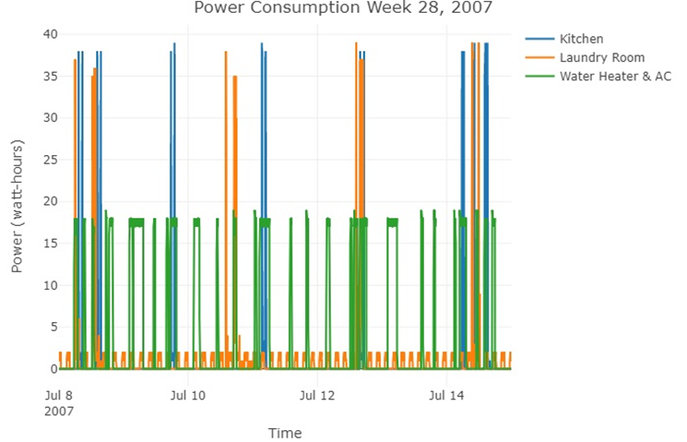
CREATING VISUALIZATIONAND ANALYSIS OF A RANDOM SUMMER WEEK, DAY, MINUTES IN 2007 & 2009
Comparing Visualizations of Summer Week in 2007 to same week in 2009

Slide 8
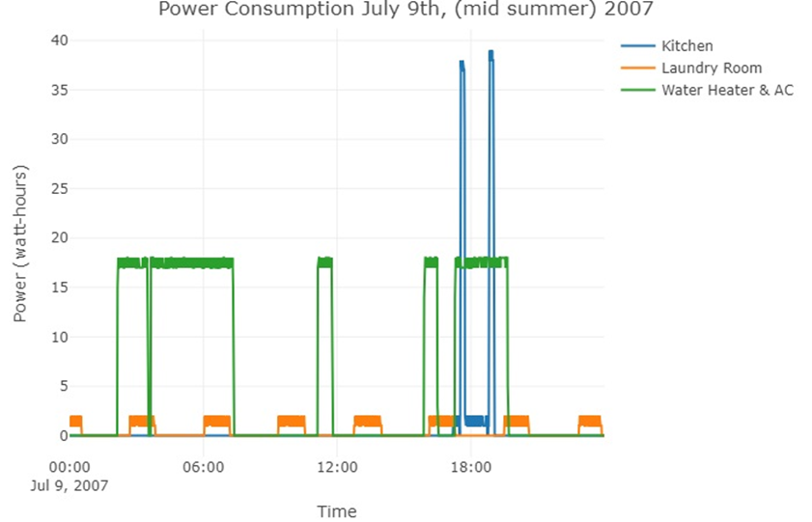
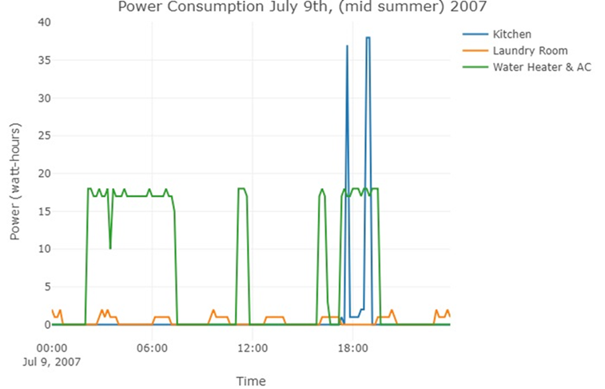
Analysis of Summer Week, Day, Minute Power Usage in 2007
Visualizations of a summer time period in 2007.
Both "Day" and "Week" highlighting typical patterns in a home.
Adjusting granularity until a visualization that maximizes information gain as shown.
10 minutes intervals provided a clearer insight
Sub-meter 3 energy usage peaked often during day and night in summer. Possibly due to more AC usage.
Kitchen appliances energy usage remain same, once or twice a day.
Laundry energy usage remain on 2 to 2 1/2 peak intervals.
Plot Showing Day Subset With Granularity
Plot Showing Day Subset With Granularity Adjustment
10 minute Intervals

Slide 9
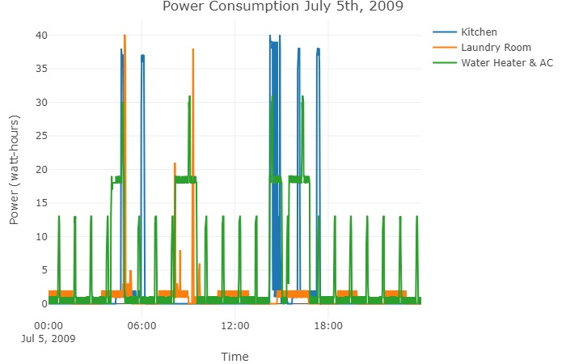
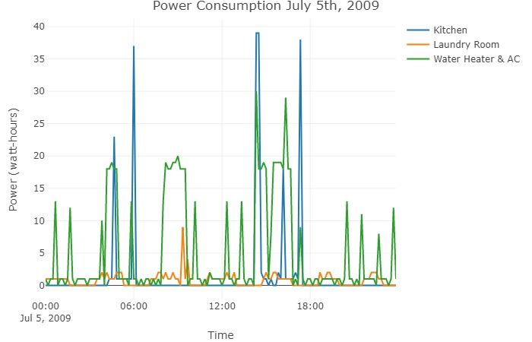
Visualizations with Analysis of Summer Day - 2009
Insight Summer 2009:
Sub-meter 3 energy usage often peaks during day and evening times in the summer. Possible due to AC usage.
Surprisingly, energy usage in the early morning hours decreases compares to 2007 and 2008.
Kitchen appliances energy usage also peaks to about 4 times during the day but not as often as AC/water heater
Laundry energy usage peaked once.
Plot Showing Day Subset With Granularity
Plot Showing Day Subset With Granularity Adjustment 10 Minutes

Slide 10
Comparing Visualizations of a Summer Day Consumption - 2007 and 2009
Comparing Insights Between Summer 2007 and 2009:
Sub-meter 3 energy usage peaked often during day and night in summer. Possibly due to more AC usage.
Kitchen appliances overall energy usage dropped.
Laundry energy usage continue a pattern of 2 to 2.5 hours peak intervals.
Through data visualization, we can identify trends and patterns in energy consumption leading to believe that may be potential for savings.
There may be a faulty water heater or AC or inefficient appliance in the home.
Lesser consumption notice in Sub-meter 2 area in 2009. Both summers of 2007 and 2009 still show similar high energy usage during same periods of the day.

Slide 11
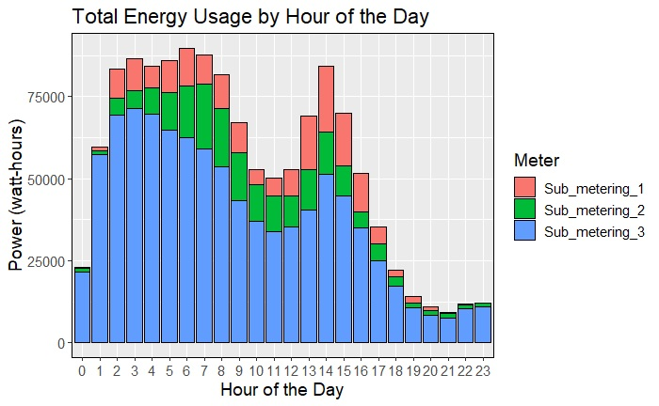
FURTHER EXPLORATION AND VISUALIZATION WITH BAR CHART FOR ANY ADDITIONAL INSIGHTS
Further insight exploration by hour of the day again confirms interesting trends in energy consumption in the four winter months of the years 2007 to 2010.
Higher energy usage is recorded between 1 AM and 9 AM and in the afternoon between 1 PM and 3 PM.
Not surprisingly, Sub-meter 3, (water heater/AC area) uses higher energy in the early morning hours and mid-afternoon hours as seen in previously visualizations.
Clearly, this home uses more energy for water heater. The water heater appliances may be working overtime, old, and obviously non energy efficient.

Slide 12
Opportunities/Recommendations Based on Visualization of Data
Assuming local electric power provider offers lower off-peak rates in the evening between 7 PM to 11 PM, the homeowner may be saving on electricity rate by shifting more energy usage particularly, laundry and water heater and AC to those off-peak hours.
Mid afternoon shows higher energy consumption on all sub-meters. Reducing energy usage during this period maybe another savings opportunity.
Compare high energy consumption between Summer and Winter of nearby house. Here, looking for insight information on energy consumption by day of the week during two critical periods of the year associated with high energy consumption. A valuable information may provide potential opportunities for homeowner's behavior modification.

Slide 13
STEP TWO: CONVERT DATA TO TIME SERIES AND VISUALIZE WITH ANALYSIS
To convert our data to a time series object, we use R’s ts() function on our subset time series data. With initial visualizations completed, the data is prepared for Time Series Analysis.
Store data frame(s) as time series with appropriate start, end, and frequency. Using the ts() function, we subset the data and then create a Time Series object.
It’s important to set the frequency argument to the correct value. For a quarterly time series, the value is set to 4. Monthly time series is set to 12, and weekly is set to 52.

Slide 14
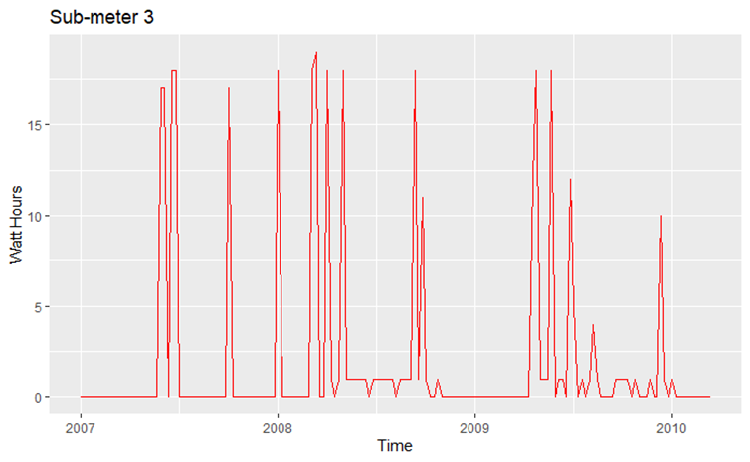
2.1 Visualizations with Analysis of Time Series Sub-meter 3
Considering this plot "autoplot" with labels and color, we can see energy consumption patterns similar to patterns observed in 2007 to 2009, both in the bar charts and scatter lines in previous visualizations.
We converted our data subset by month into a time series object by setting the frequency to 12

Slide 15
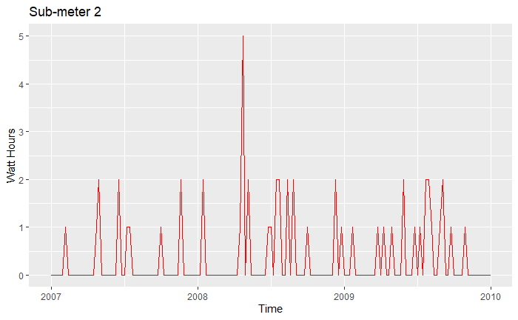
2.2 Visualizations with Analysis of Time Series Sub-meter 2
Same patterns is observed here in Sub-meter 2 from the over the years.

Slide 16
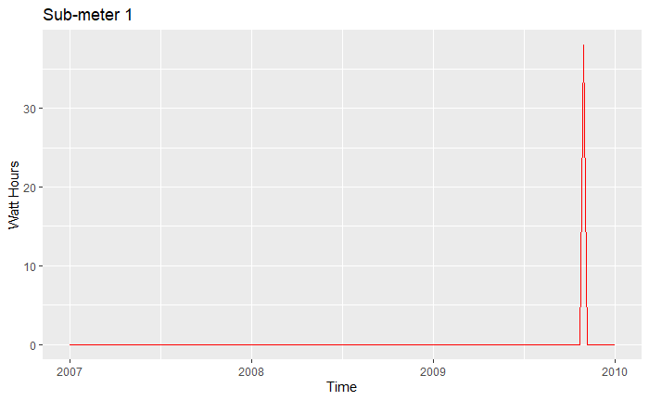
2.3 Visualizations with Analysis of Time Series Sub-meter 1
Here, we can see the same low energy consumption patterns observed previously in 2007 to 2009, both in the bar charts and scatter lines.
Consumption increased in late 2009 but suddenly decreased in 2010.

Slide 17
STEP 3: LINEAR REGRESSION FORCAST/PREDICTION OF A TIME SERIES SUB-METER OBJECTS VISUALIZATION AND ANALYSIS COMPARING R2 and RMSE of EACH MODEL
Focusing on submeter 3 which accounts for much of the total Sub-meters energy consumption. We use Linear Regression model lm() for prediction and forecasting of future consumption trends.
We first fit a linear model to the weekly data previously created.
Create three different time series linear models for three different time periods using the tslm and forecast functions.
We forecast the trends of each time series model created.
Use the summary() for a quick assessment of the model. However, using glance() function provides easy to read tabular outputs.
RMSE 5.85 for Sub-meter 3 indicates the fit of the linear regression model to the data, which is how close the observed data points are to the predicted values. Obviously, the lower the RMSE, the better the model fits.
Sub-meter 3 Model Performance Metrics
r.squared <dbl> | adj.r.squared <dbl>
p.value <dbl> | df <int>
0.3919856 | 0.08797838
0.1367273 | 53
Sub-meter 2 Model Performance Metrics
r.squared <dbl> | adj.r.squared <dbl>
p.value <dbl> | df <int>
0.3145623 | -0.02815652
0.6282554 | 53
Sub-meter 1 Model Performance Metrics
r.squared <dbl> | adj.r.squared
p.value <dbl> | df <int>
0.4342033 | 0.151305
0.03280012 | 53

Slide 18
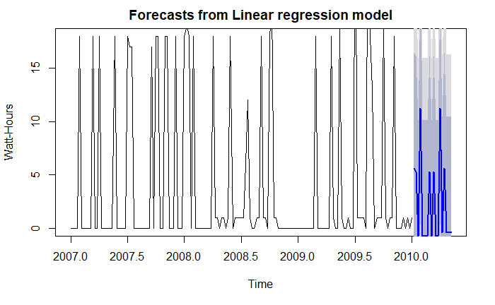
3.1 Forecast from Linear regression Model of Sub-meter 3 - Visualizations with Analysis
Insight Analysis:
To make a forecast with Sub-meter 3 linear model, we passed the model, the number of time periods, and the confidence level for the prediction interval.
The forecast plot to the right shows a trend line plot of the predicted values. The dark grey area is 80% prediction intervals and the light grey is the 90% prediction interval. The dark blue line is the average of the forecasted points.
Sub-meter 3 is predicted to continue with high energy peaks but lower energy consumption in the future. The trend shows skewed pattern from historical trends analyzed.
Interestingly, the R-squared: 0.392 is significantly very low, and the p-value: 0.1367 does not seem to signify that at least one of the predictors or predictors jointly are statistically significant. With a very low R-squared >1, it could mean that the linear regression model was not a good fit.
However, this forecast shows this area of the house will continue with high energy consumption if no measure is taken to address it.

Slide 19
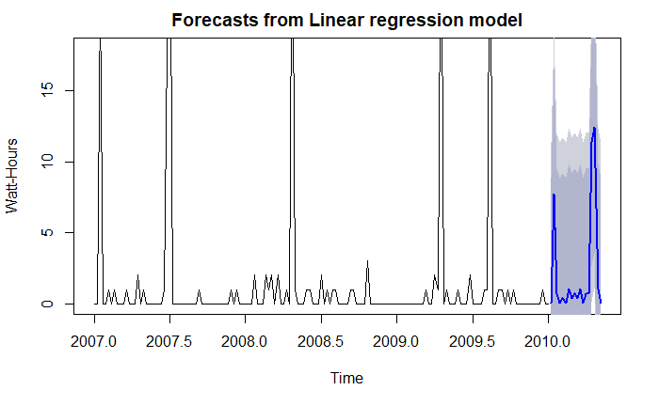
3.2 Forecast from Linear regression Model of Sub-meter 2 - Visualizations with Analysis
Insight Analysis:
Sub-meter 2 forecast plot shows a trend line plot of the predicted values with the 80 and 90% prediction intervals.
Sub-meter 2 is predicted to continue low energy consumption in the future. The trend shows energy consumption will drop in the near future but steadily increases in later time. Similar pattern to the historical data visualization.
R-squared: 0.31 is significantly very low, RMSE is 5.47, and the p-value: 0.62 does not seem to signify that at least one of the predictors or predictor(s) jointly are statistically significant.
R-squared from Sub-meter 2 is lower than Sub-meter 3 linear regression model.

Slide 20
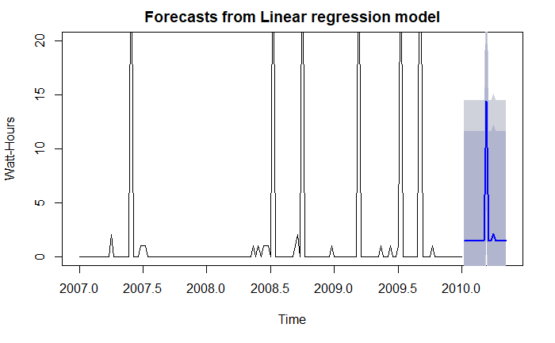
3.3 Forecast from Linear regression Model of Sub-meter 1 - Visualizations with Analysis
Insight Analysis:
Sub-meter 1 is predicted to continue lowest energy consumption in the future among the three Sub-meters. The trend shows similar pattern from historical trends analyzed.
R-squared: 0.43 is low, RMSE is 5.47, and the p-value: 0.03 does seem to signify that at least one of the predictors or predictor(s) jointly are statistically significant.
This model seems to fit better than models for Sub-meter 3 and 2.
Actual energy consumption that falls outside of a predicted interval could alert of a potential issue with an appliances in the area.

Slide 21
STEP 4: DECOMPOSITION VISUALIZATION AND ANALYSIS OF SEASONAL TIME SERIES OF THE SUB-METERS
According to The Little Book of R: “A seasonal time series consists of a trend component, a seasonal component and an irregular component. Decomposing the time series means separating the time series into these three components: that is, estimating these three components.”
When analyzing the trend of a time series independently of the seasonal components, seasonal adjustment method is used to remove the seasonal component of a time series that exhibits a seasonal pattern.
In order to correctly estimate any trend and seasonal components that might be in the time series, the decompose() function in the forecast package is used. This estimates:
the trend
seasonal
and irregular components of a time series.
When the decompose() function is used, three different objects (Seasonal component, Trend component, Random component) are created.

Slide 22
4.1 Decomposition Analysis Chart Summary Statistics for Each Decomposed Object’s Seasonal, Trend and Random/Remainder components
Summary statistics for decomposed Sub-meter 3
Summary statistics for decomposed Sub-meter 2
Length Class Mode
x 157 ts numeric
seasonal 157 ts numeric
trend 157 ts numeric
random 157 ts numeric
figure 52 -none- numeric
type 1 -none- character
Length Class Mode
x 157 ts numeric
seasonal 157 ts numeric
trend 157 ts numeric
random 157 ts numeric
figure 52 -none- numeric
type 1 -none- character
Summary statistics for decomposed Sub-meter 1
Length Class Mode
x 157 ts numeric
seasonal 157 ts numeric
trend 157 ts numeric
random 157 ts numeric
figure 52 -none- numeric
type 1 -none- character

Slide 23
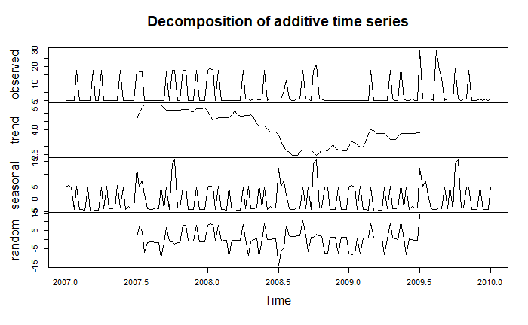
4.2 Decomposition Visualizations with Analysis – Sub-meter 3
Decomposition Insights:
The plot shows the original time series (observed), the estimated trend component (trend), the estimated seasonal component (seasonal), and the estimated irregular component (random).
We can see that the estimated trend component shows a huge decrease from about 5.0 in 2007 to 2.5 in mid 2008. Followed by gradual but zig zag increase around 3rd quarter of 2008 to about mid of 2009.
This information will be important to a homeowner trying to understand their power consumption trends.
The estimated seasonal factors are given for the period 2007 to 2010 and are the same for each year. The largest seasonal factor is (about 15.59), and the lowest is (about -4.54), indicating that there seems to be a peak and a trough in power consumption during this period.
The drop-in energy consumption may be caused by a change in the homeowner energy usage behavior or activities in Sub-meter 3 area.

Slide 24
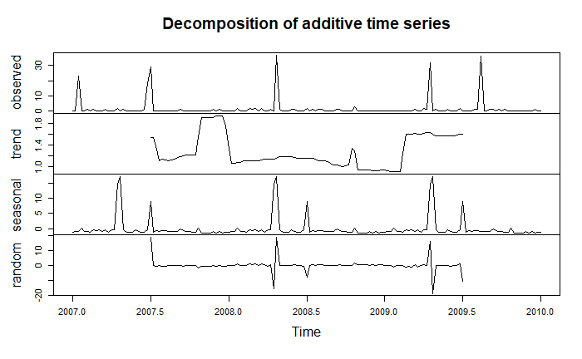
4.3 Decomposition Visualizations with Analysis – Sub-meter 2
Decomposition Insights:
Sub-meter 2 shows unclear trend in energy usage.
Power usage seem to peak at end of 2007 but drastically decreased and remained constantly low most part of 2008.
Energy usage rapidly increased at beginning of 2009. This could be caused by any factor like removal of energy-saving appliance from the laundry area.
Sub-meter 2 shows seasonal effects on power usage during middle of each year.

Slide 25
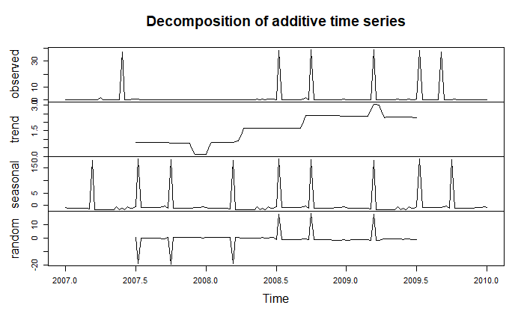
4.4 Decomposition Visualizations with Analysis – Sub-meter 1
As shown in the plot, Sub-meter 1 also show a trend in energy usage.
Power usage increases from early 2008 to end of 2009. Interestingly, power usage holds constantly high for the first half of 2009.
Not surprisingly, Sub-meter 1 does not show seasonal effects on power usage because kitchen activities my not be affected by seasonal factors like weather.
Unlike Sub-meter 3 area, energy consumption in the kitchen area seems to increase from the lowest point in late 2007 to its peak in early 2009.
Number of home occupants may have increased hence more usage of the kitchen appliances for cooking.
Energy consumption is clearly trending high in the kitchen area.
Energy saving appliances are recommended.

Slide 26
STEP 5: HOLT WINTERS FORCASTING AND ANALYSIS Holt Winters forecast of 3 sets consisting of sub-meters 1, 2 and 3. Each set is composed from the forecast plot and plot containing only the forecasted area.
Holt Winters function is used to remove seasonal components of the forecast.
HoltWinters() function from the stats package helps to make forecasts more realistic.
We can fit a simple exponential smoothing predictive model using HoltWinters().
To use HoltWinters() for forecasting, seasonal component that was identified from decomposition must first need to be removed by using Seasonal adjusting.

Slide 27
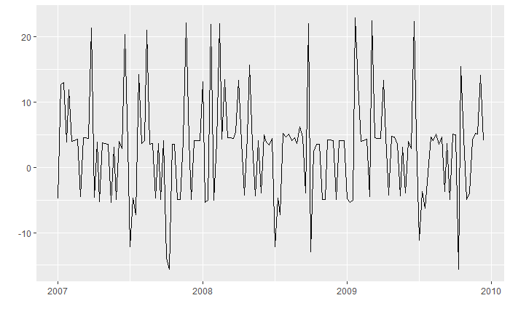
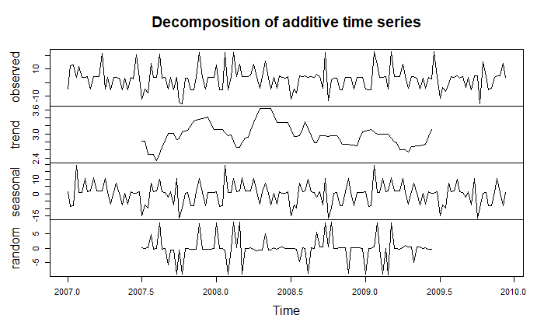
5.1 Seasonal Adjusting Sub-meter 3
The plot shows the Seasonal Adjustment of Sub-meter 3 by subtracting the seasonal component before plotting
Plot Showing Removal of Seasonal Component
To confirm removal of seasonal component, we decomposed again to test Seasonal Adjustment.
Note the very, very small scale for Seasonal.
Although, there is a seasonal line, however we verify removal of seasonality by looking at the scale for the seasonal section. -1.0e-15 through 1.0e-12.5 indicate a decimal with very small number. This confirms the seasonality removal.
Plot Confirmation of Seasonal Adjustment

Slide 28
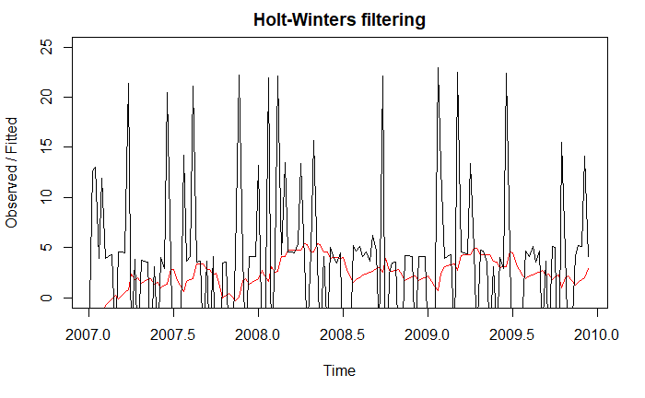
5.1.1 Holt Winters Exponential Smoothing & Plot - Sub-meter 3
In this plot the exponentially smooth fitted line is plotted in red along with the original data points.
To understand how does exponential smoothing help, we consider the outliers. Here, all the information or data removed when we subset millions of data points to just 52 observations per year.
This plot shows the original time series in black, and the forecasts as a red line.
The time series of forecasts is much smoother than the time series of the original data.
As a measure of the accuracy of the forecasts, we calculate the sum of squared errors for the in-sample forecast errors, that is, the forecast errors for the time period covered by our original time series.
Holt Winters Exponential Smoothing & Plot

Slide 29
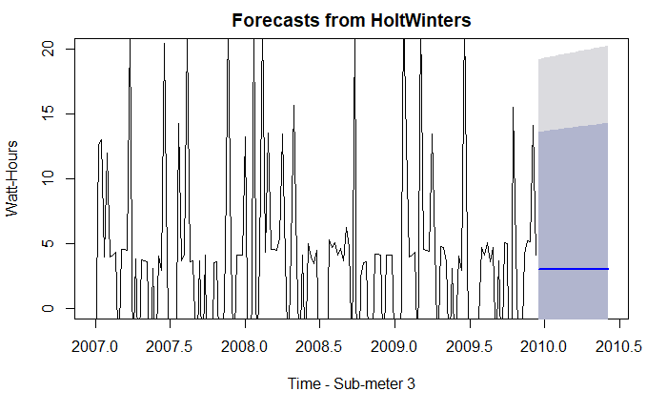
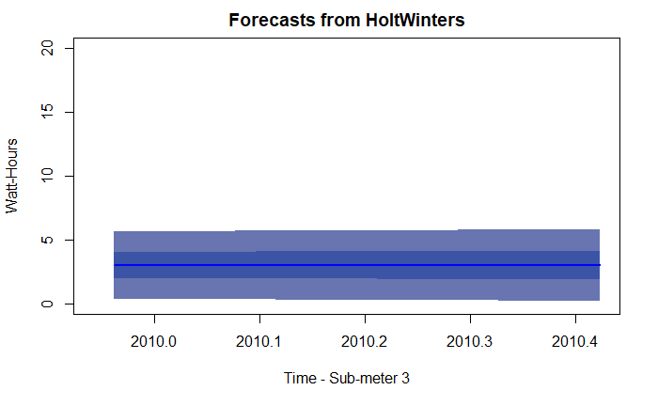
5.1.2 Holt Winters Forecast
Run another Forecast after creating a time series object that contains exponentially smoothed data with no seasonality as shown on the grey area of the plot.
Fine tune by changing the confidence levels and then plot only the forecasted area.
The plot to the right shows only the energy consumption forecast for Sub-meter 3 area after removing seasonality and historical trend.
Approaching from a weatherperson perspective: The preceding years, weeks and days are not usually included in the weather forecast.
This shows a very consistent forecast for sub-meter 3

Slide 30
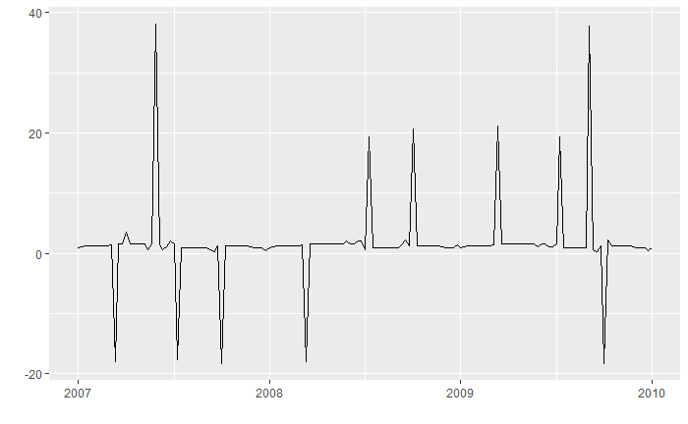
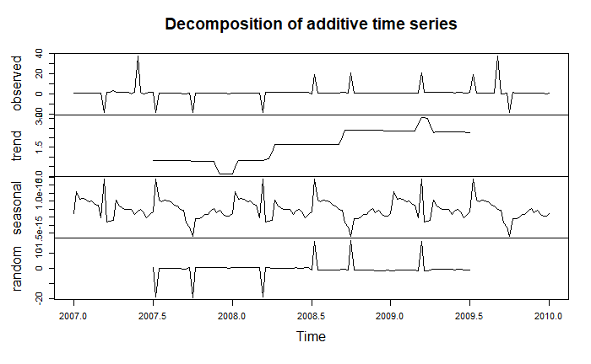
5.2 Seasonal Adjusting Sub-meter 1
Further HoltWinters Visualizations with Analysis Sub-meters 1 and 2 Using Same Frequency and Time Period
The plot shows the Seasonal Adjustment of Sub-meter 3 by subtracting the seasonal component before plotting
Plot Showing Removal of Seasonal Component
To confirm removal of seasonal component, we decomposed again to test Seasonal Adjustment. .
Although, there is a seasonal line, however we verify removal of seasonality by looking at the scale for the seasonal section. -5.0e-15 through 1.0e-10.5 indicate a decimal with very small number. This confirms the seasonality removal.
Plot Confirmation of Seasonal Adjustment

Slide 31
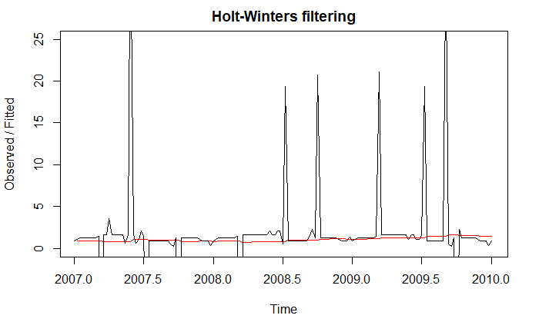
5.2.1 Holt Winters Exponential Smoothing & Plot - Sub-meter 1
In this plot, the exponentially smooth fitted line is plotted in red along with the original data points.
The plot shows the original time series in black, and the forecasts as a red line.
The time series of forecast is much smoother than the time series of the original data.

Slide 32
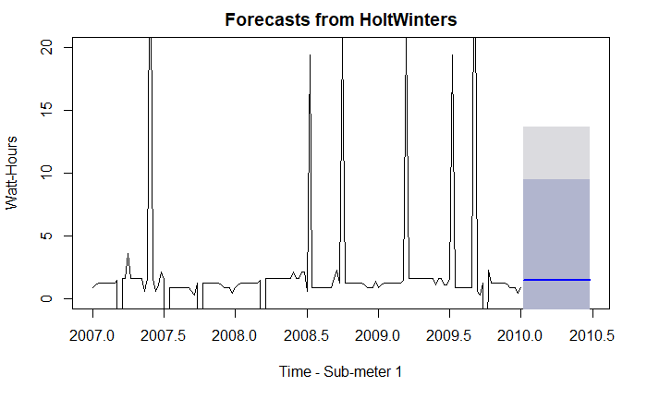
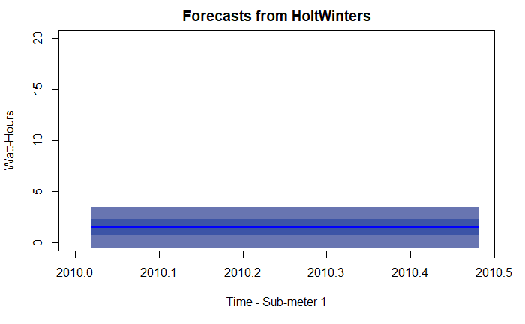
5.2.2 Holt Winters Forecast
Run another Forecast after creating a time series object that contains exponentially smoothed data with no seasonality as shown on the grey area of the plot.
Fine tune by changing the confidence levels and then plot only the forecasted area.
The plot to the right shows only the energy consumption forecast for Sub-meter 1 area after removing seasonality and historical trend.
The plot to the right shows a very consistent forecast for Sub-meter 1

Slide 33
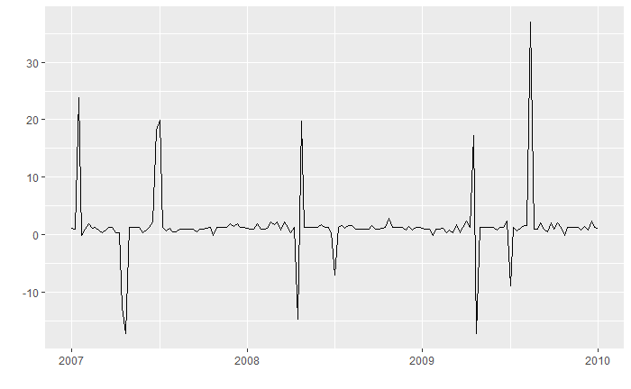
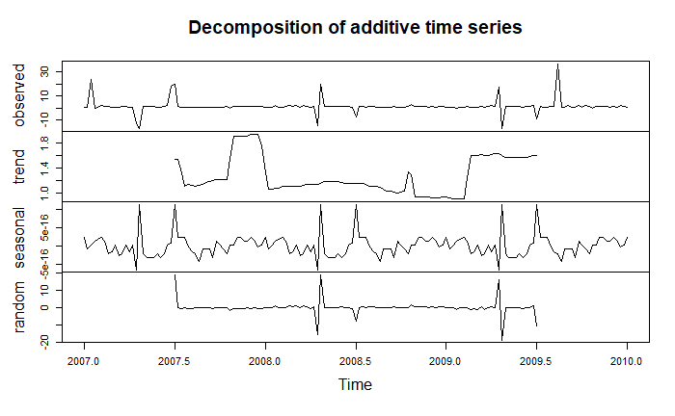
5.3 Seasonal Adjusting Sub-meter 2
Further HoltWinters Visualizations with Analysis Sub-meters 2 Using Same Frequency and Time Period as 3 and 1
The plot shows the Seasonal Adjustment of Sub-meter 2 by subtracting the seasonal component before plotting
Plot Showing Removal of Seasonal Component
To confirm removal of seasonal component, we decomposed again to test Seasonal Adjustment. .
Although, there is a seasonal line, however we verify removal of seasonality by looking at the scale for the seasonal section. -5.0e-16 through 5.0e-16 indicate a decimal with very small number. This also confirms the seasonality removal.
Plot Confirmation of Seasonal Adjustment

Slide 34
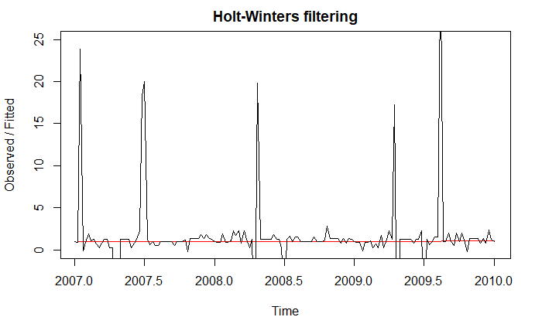
5.3.1 Holt Winters Exponential Smoothing & Plot - Sub-meter 2
In this plot the exponentially smooth fitted line is plotted in red along with the original data points.
This plot shows the original time series in black, and the forecasts as a red line.
The time series of forecasts is smoother than time series and shows a straight horizontal line.

Slide 35
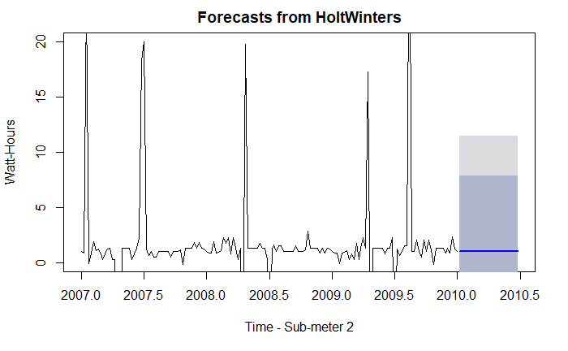
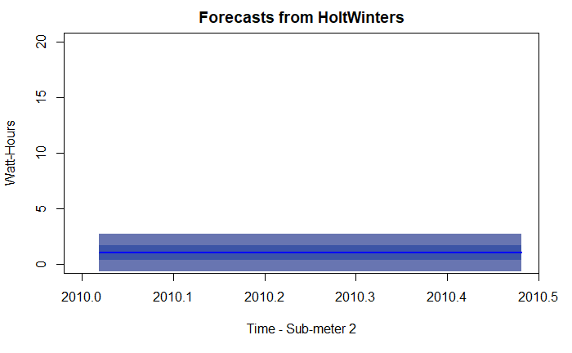
5.3.2 HoltWinters Forecast
Run another Forecast after creating a time series object that contains exponentially smoothed data with no seasonality as shown on the grey area of the plot.
Fine tune by changing the confidence levels and then plot only the forecasted area.
The plot to the right shows only the energy consumption forecast for Sub-meter 2 area after removing seasonality and historical trend.
The plot to the right shows a very consistent forecast for Sub-meter 2

Slide 36
6. ANY USEFUL CORRELATIONS OR PREDICTIONS FROM DATA
HoltWinters forecast for Sub-meters 1 and 2 seem to be correlated.
The forecast for Sub-meter 3 area energy consumption looks different from other areas. Again, this could be due to high energy consumption in Sub-meter 3 area and low performance matric obtained from the linear regression model.
The relationship between these forecast is not certain.
More analysis will be required to separate water heater energy consumption from AC. Having higher energy consumption in the winter months in Sub-meter 3 area seems unreal.
Could there be a central Heat/AC system in the house?

Slide 37
7. SUMMARY STATEMENT
The main goals of this project was to determine what kind of analytics and visualizations that would empower Smart Home owners with greater understanding and control of their power usage. Considering the objective of our potential client, which is to offer highly efficient Smart Homes that provide their customers with power usage analytics.
As a data analyst working with a potential real estate developer client, this project was approached hoping that the analytics on these sub-meters will provide insights that would encourage homeowners to install sub-meters in their homes. As a result would help our client grow their business. This summary is based on the results of these objectives mind.
Sub-metered Energy Consumption Data.
Valuable insights were uncovered when sub-setting the data into months, weeks, days, weekdays, hours and minutes of the day. With adjusted granularity, we were able to uncover trends in behavior or appliances’ performance. For instance, visualization of energy consumption on 10 minutes intervals of a day of the week during winter months, we were able to determine that the Sub-meter 3 (water-heater and AC) area used most of the energy in the early morning hours. A surprising behavior considering the expectation that there should be little or no activities in the house during this period.

Slide 38
7. SUMMARY STATEMENT
Concentrating of our analysis on Sub-meter 3 which accounted for most of the high energy usage. The yearly, quarterly, and monthly comparison plots of energy usage showed period of noticeable troughs and peaks in this area. However, the interesting insight on the trends of energy usage and appliance performance in submeter 3 area during winter is counterintuitive as the AC system would not be used in the winter. This led us to believe that, the water heater might have been faulty and working overtime to maintain the temperature set point if it’s in a poorly insulated space. This insight could be highlighted to a homeowner as an opportunity for cost savings by simply insulating the water heater.
Identification of Energy Usage Trends and Forecast
The decomposition visualizations provided valuable insights on energy usage trends in different monitored areas of the house. The visualizations after separation of the original time series (observed), the estimated trend component (trend), the estimated seasonal component (seasonal), and the estimated irregular component (random) is very informative and could be used to modify energy usage behaviors.
We can see how the estimated trend component showed a huge decrease in energy usage in Sub-meter 3 area from high peaks in 2007 to troughs in mid 2008. Followed by gradual but zig zag increase around 3rd quarter of 2008 to about mid of 2009.
This information will be important to a homeowner trying to understand their power consumption trend.

Slide 39
7. SUMMARY STATEMENT
Visualization and Identification of Potential Energy Savings.
Deeper analysis and visualization of energy consumption by minutes and hours of the day showed noticeable periods of peak and low usage. This insight provides an opportunity for possible energy cost savings if the local electric company decides to offer peak and off-peak rates.
Prediction and Forecast of Patterns of Energy Usage
Still focusing on Sub-meter 3, We use Linear Regression model for prediction and forecasting of future consumption trends. Linear regression models were fit to weekly time series data for all three sub-meters and future energy consumption were predicted.
Created three different time series linear models for three different time periods using the tslm and forecast functions. The trend of each time series model was forecasted.
A quick assessment of the model using glance() function provided easy to read tabular outputs of the model performance metrics.

Slide 40
8. HIGH LEVEL RECOMMENDATIONS
High-Level Recommendations based on your visualization and analysis of the power consumption data includes:
Use the low usage trend to identify a faulty or degrading appliance(s) that exhibits unusual energy consumption in the future.
A deviation from predicted energy usage could be a more proactive way to identify potential higher usage behavior of an appliance or confirmation of solved high usage problem.
The visualization and analysis of the data provides those time periods the homeowner could benefit from off-peak rates if offered by the local electric provider. Using timing devices on the appliances like washer and dryer and the dishwasher could be beneficial during these off-peak periods.
Obviously, there’s need for energy efficient water heater.

Slide 41
9. LESSONS LEARNED
There must be a clear simple but well thought out plan of attack.
Big data could be good source of information for predictions of future behaviors.
Proper and well-structured steps must be taken when working with time series data.
Converting the data time zone to US.
With such a big data set, focus the analysis on specific goals. Not broad objectives because of notion that there will be a lot to uncover.
Keep track of all the data objects, data frames created to avoid mix-ups.
Such a project requires strict attention to details in each visualization and analysis.
It’s highly recommended to understand the business domain and/or client’s business operations for better analysis.
If the data is not cleaned, it must first be cleaned for optimal analysis.
Data governance needs to be addressed.
Analysis could be done on sample of the data set faster and for more in-dept than whole data set.
There are multiple approach to this project: both R dplyr and ggplot2 provides good insight visualizations.
HoltWinters forecast is a valuable tool for time series data realistic forecasting and predictions.
For proper prediction of a time series data, one must account for seasonal, trend, and random components as well.

